Slide 1

Movie Recommendation System using Kmeans Clustering
Movie Recommendation System

Slide 2

Abstract
The main focus of this presentation:
Develop a K-means clustering method to recommend movies to a user by watching a movie.

Slide 3

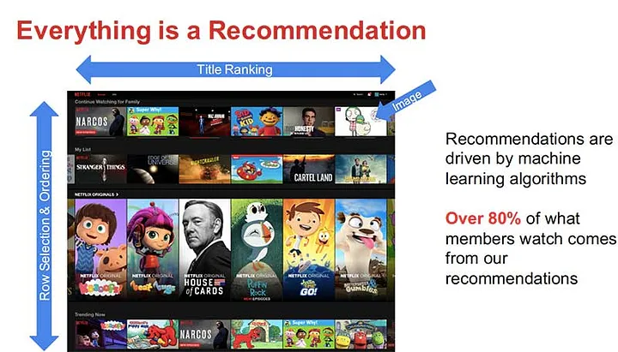
Abstract
Recommender systems predict consumers’ preferences for products and provide proactive suggestions for items they would enjoy.

Slide 4
Abstract
most common types of recommendation models:
Collaborative filtering
content-based
Hybrid recommendation

Slide 5
Abstract
Collaborative filtering generates suggestions based on previous interactions between the user and the item
Majority of content-based recommendations are based on item comparisons.
The majority of hybrid recommender systems are made up of a mix of collaborative filtering and content-based recommender models

Slide 6
Abstract
The Content-Based method was used as the main model in this study, k-means clustering can be applied in certain recommendation scenarios by selecting appropriate features.

Slide 7
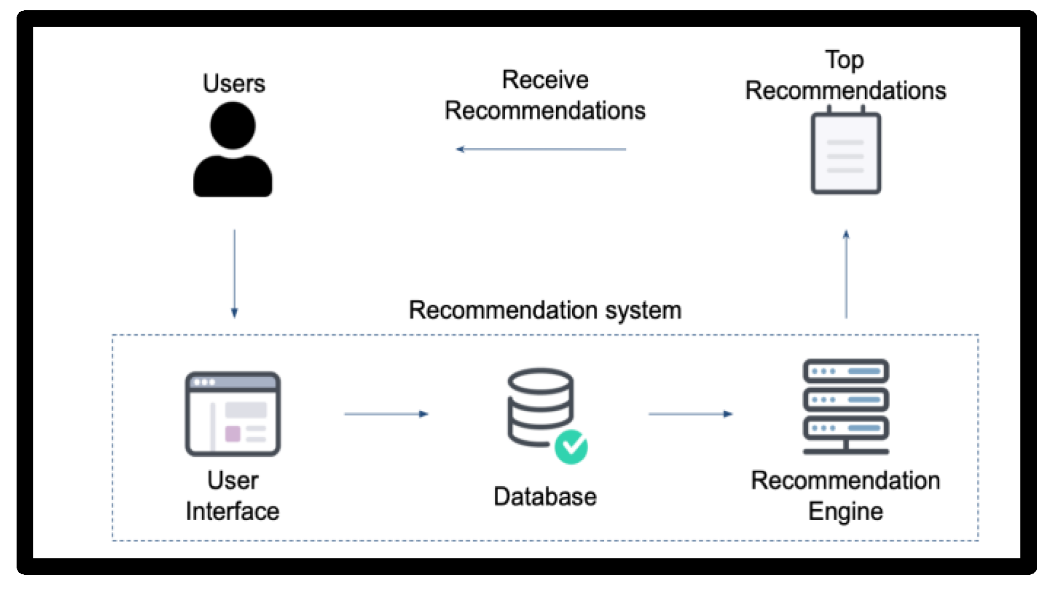
Introduction
A recommendation system is a program that employs various filtering algorithms to deliver suggestions and forecasts to users.

Slide 8
Introduction
The movie business has grown in recent years, with hundreds of films made practically every year; as a result, consumer over-choice has become a problem. As a result, both business and research have embraced movie recommendation systems. Many approaches have been taken in developing recommendation systems.

Slide 9
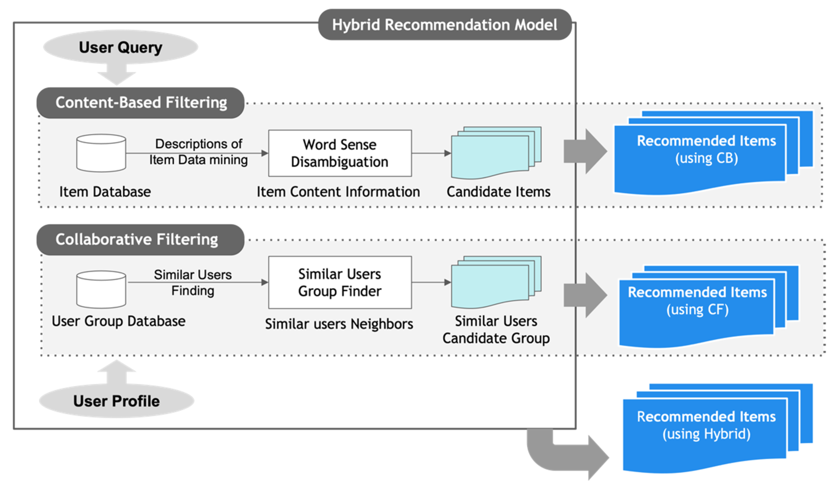
Introduction
What’s our approach?
we offer a collaborative filtering recommendation system based on content. We utilize a keywords feature extraction technique for the content-based approach.

Slide 10
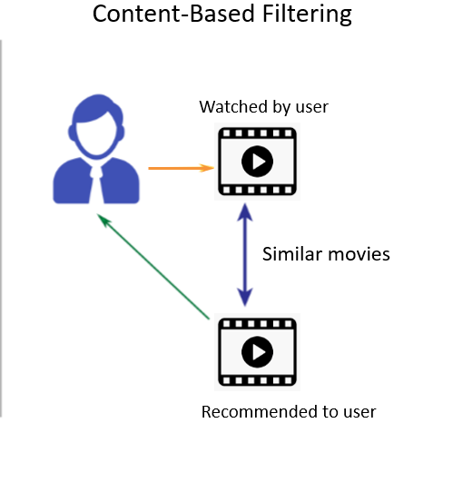
Introduction
General overview of
content-based recommendation systems

Slide 11
Content-Based
A content based recommender works with data that the user provides, either explicitly (rating) or implicitly (clicking on a link). Based on that data, a user profile is generated, which is then used to make suggestions to the user. As the user provides more inputs or takes actions on the recommendations, the engine becomes more and more accurate.

Slide 12
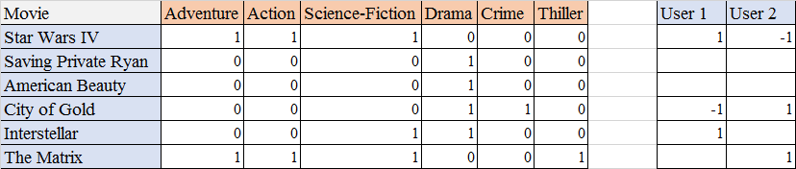
Content-Based (cntd)
This method uses some information that can extract item characteristics as training data.
Some content-based movie recommendation systems employ movie metadata (e.g. movie genre, cast, director of the movie) as input.

Slide 13
Content-Based (cntd)
Text documents are the other most common information source for content-based recommendation systems and we can get help from NLP to process content.

Slide 14
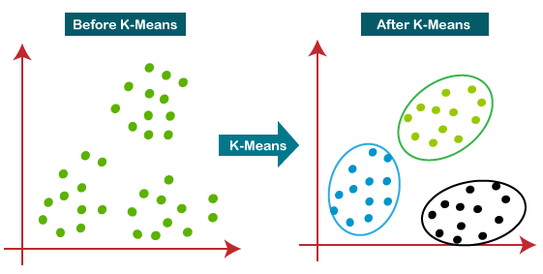
K-means
K-means clustering is a popular machine learning algorithm used for grouping similar data points into clusters. While it is not typically used directly for movie recommendation systems, it can be applied as a part of the recommendation process.

Slide 15
K-means (cntd)
In movie recommendation systems, clustering techniques like k-means can be employed to identify groups movies with similar characteristics. This is often done by analyzing features such as movie genres, actors, directors, user ratings, or other relevant attributes.
In the context of movie recommendation, content-based k-means clustering can be used to group movies together based on their attributes or content characteristics. These attributes could include genres, actors, directors, plot keywords, or any other relevant information that describes the movie.

Slide 16
K-means (cntd)
Here's a general outline of how content-based k-means clustering can be applied in movie recommendation:
Data collection: Gather data on movies, including attributes such as genres, actors, directors, plot keywords, and any other relevant information.
Feature extraction: Represent each movie as a feature vector that captures its content attributes. For example, you could create a binary vector where each dimension represents the presence or absence of a specific genre, actor, or director in the movie.
Feature normalization: Normalize the feature vectors to ensure that different attributes are on a similar scale. This step is important for accurate clustering.

Slide 17
K-means (cntd)
4. Clustering: Apply the k-means algorithm to cluster the movies based on their feature vectors. The algorithm will group similar movies together into clusters, where similarity is determined by the content attributes.
5. Cluster analysis: Analyze the resulting clusters to understand the relationships between movies based on their content. This can help identify groups of movies with similar characteristics.
5. Recommendation generation: Once the clusters are formed, you can recommend movies to users based on their preferences. For example, if a user expresses a preference for a specific movie, you can recommend other movies from the same cluster as similar content-wise.

Slide 18
K-means (cntd)
Content-based k-means clustering can provide recommendations based on the similarity of movie content attributes. However, it is important to note that this approach does not consider user preferences or feedback. Therefore, it may not capture more nuanced or personalized recommendations that collaborative filtering methods can provide.
To enhance the recommendation system, a hybrid approach can be employed by combining content-based filtering with collaborative filtering techniques. This allows for a more comprehensive recommendation process that takes into account both content attributes and user behavior.

Slide 19
Methodology

Slide 20

Data
We use set of MovieLens datasets:
Dataset that retrieved from the MovieLens website, which has 27,753,444 ratings and 1,108,997 tag applications scattered across 58098 movies and was gathered between January 9,1995 and September 26, 2018, and was made by 283,228 people.
We use 3384 record of movies for our recommender system

Slide 21
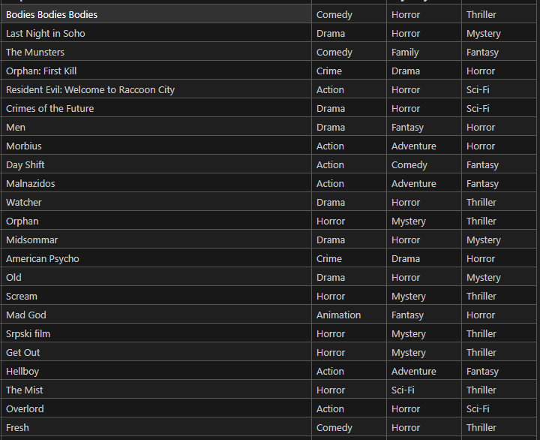
Data

Slide 22
Models and Feature Extraction
We use only movies dataset from MovieLens dataset, we select below features as clustering features:
Movie Name
Primary Genre
Secondary Genre
Tertiary Genre

Slide 23
Results (CB)
In this section, we will go through the outcomes of our
recommendation system.
CHART

Slide 24
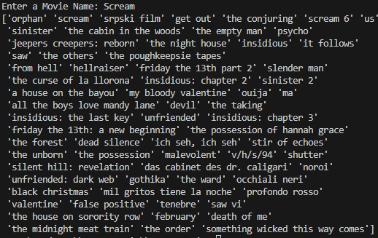
Results (CB)
In example, with we want similar movies to “Scream” movie, we receive this result:

Slide 25
Results (CB)
From the set, a total of 244 movies were recommended, with an average of 34 movies recommended per movie (it means total of two CB recommender).
Once movies put into recommendation algorithm (match of two algorithms) We receive an average of 7 movies recommended per title supplied from the entire movies that were recommended, demonstrating that we can combine RAKE and TF-IDF to recommend movies using movie plot and extracting the similar movies acquired by utilizing the keywords extraction models.

Slide 26
Results (CB)
The combined findings demonstrate that there is a significant chance that utilizing separate keyword extractors and picking movies that are the same from each extraction recommendation system would likely propose movies that the viewer will appreciate.

Slide 27
Results (CF)
The test run on the recommendation system’s Collaborative Filtering component to forecast user rating yielded a mean squared error of 1.0172 on the test set. To decrease this score, we first used KNN and SVD models, as well as 10 fold cross validation with RMSE and MAE as metrics.
Both training and testing times were reduced in terms of performance.
When it came to training time, the KNN model outperformed the SVD, and when it came to testing time, the SVD outperformed the KNN model.

Slide 28
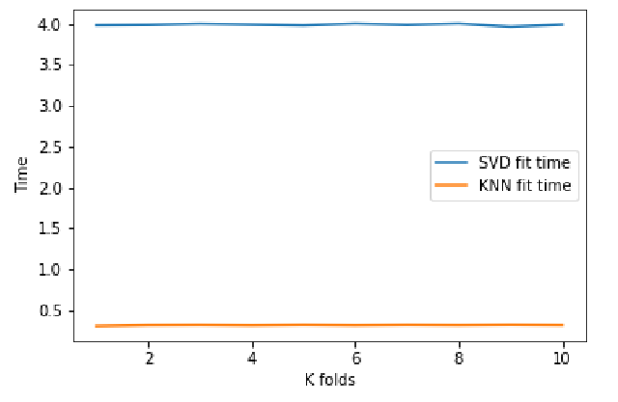
Results (CF)
SVD VS KNN with respect to training time

Slide 29
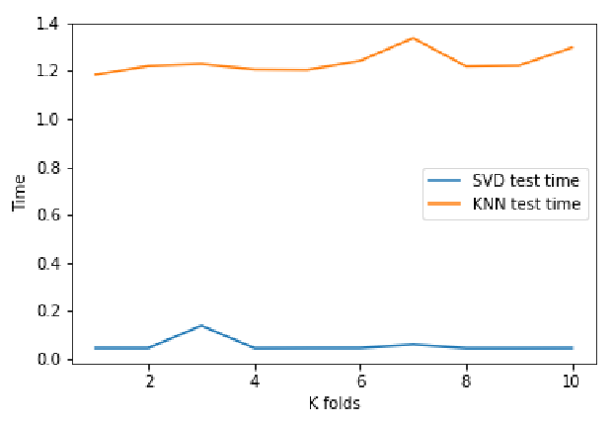
Results (CF)
SVD VS KNN with respect to testing time

Slide 30
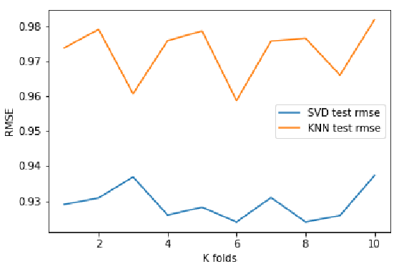
Results (CF)
The RMS error for the KNN model was 0.97, whereas the MAE averaged 0.77. The RMS error for the SVD model is typically 0.92, with an average MAE of 0.76

Slide 31
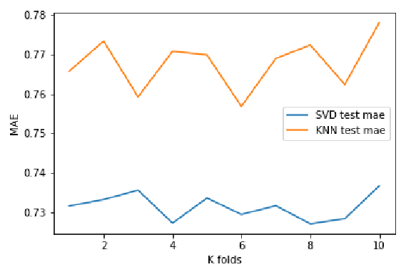
Results (CF)
MAE

Slide 32
Results (CF)
To assess the validity of our KNN and SVD models, we performed an RMSE-MSE comparison test with four additional models: NMF,SVD++, KNN with Z Score, and CoClustering.
As a baseline, we predicted the identical user’s ratings using all of the models, and the SVD++ model performed better than all of the other models, with the lowest RMS error score of 0.90 and MA error value of 0.70. With 0.91 for the RMSE and 0.72 for the MAE, our SVD model has the second best per error scores.
When compared to the other models, our KNN model performed the poorest, with error values of 0.95 for RMSE and 0.75 for MAE.

Slide 33
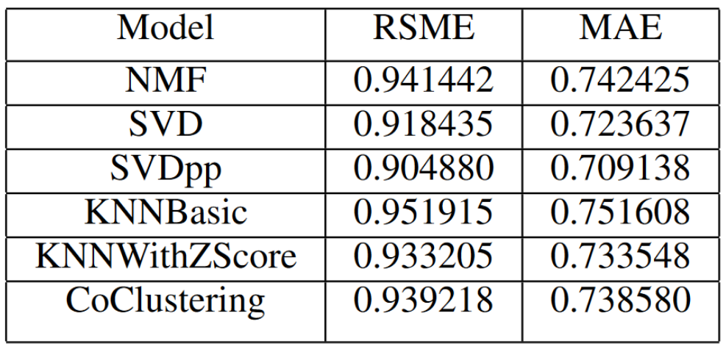
Results (CF)

Slide 34
Results (CF)
In general, SVD delivers more accurate predictions than
KNN, but the findings also reveal that CoClustering model outperforms our basic KNN model, but KNN with Z Score outperforms both basic KNN and CoClustering model.
These findings demonstrate that the best model to use for predicting user ratings is the SVD++, and KNN with Z Score would outperform a standard KNN model when it comes to predicting user ratings.

Slide 35
CONCLUSION
The results of combining TF-IDF and RAKE to suggest movies based on the movie plot demonstrate that we can combine RAKE and TF-IDF to recommend movies based on the movie plot and extract comparable movies obtained by using keywords extraction models. There is a significant chance that utilizing separate keyword extractors and picking movies that are the same from each extraction recommendation system would likely propose movies that the viewer will appreciate.

Slide 36
CONCLUSION
SVD++ is the best model to use for predicting user ratings, and KNN with Z Score would outperform a standard KNN model when it comes to predicting users’ ratings. We can see another path to movie recommendation systems with the combination of a CF predicting user ratings with minimal error, which will help with the development of movie recommendation systems.

Slide 37
Thanks for attention ☺

